Slide 1
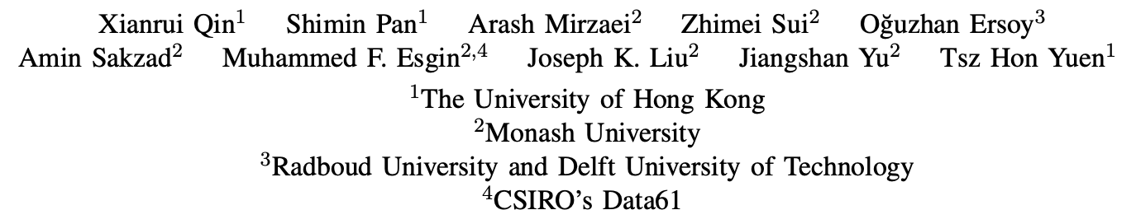
BlindHub: Bitcoin-Compatible Privacy-Preserving Payment Channel Hubs Supporting Variable Amounts
IEEE S&P 2023
汇报人：赵路路

Slide 2
Outline
Background
Preliminaries
Overview
Blind Adaptor Signature
Blind Channel
Blind Hub
Performance Analysis

Slide 3
1 Background

Slide 4
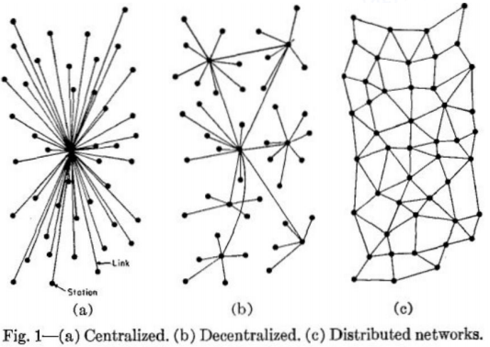
1.1 Payment Channel
Two users open a payment channel and perform off-chain payments by updating the channel state enjoying high payment throughput and low confirmation delay.
If there are more than two users, each pair of users needs to establish their own payment channel to facilitate the payment, which is a non-scalable approach.
Payment Channel Networks (PCN) enable two users with no direct payment channel to pay each other through the channels of some intermediaries.
PCN payments may require multi-channel paths and intermediaries to actively participate in relaying the payments, which can lead to their failure.
Centralized
Decentralized
Distributed

Slide 5
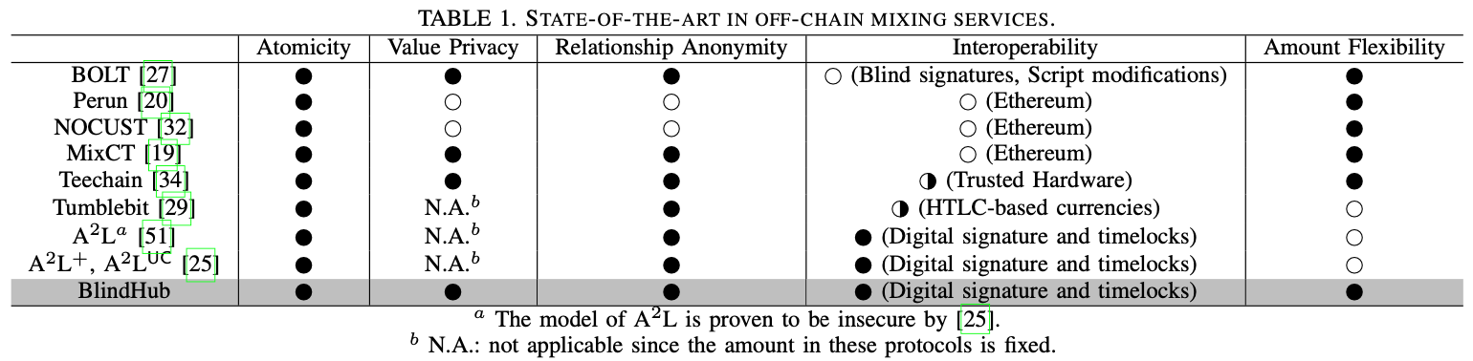
1.2 Challenges in Privacy-Preserving PCH
Atomicity: For any payment of m coins from S to R, the PCH should ensure that either R receives m coins from T and T receives m coins from S, or both parties receive none.
Value Privacy: T should not know the payment amount between S and R.
Relationship Anonymity: T should not be able to find out if there is any relation between S and R of a specific payment.

Slide 6
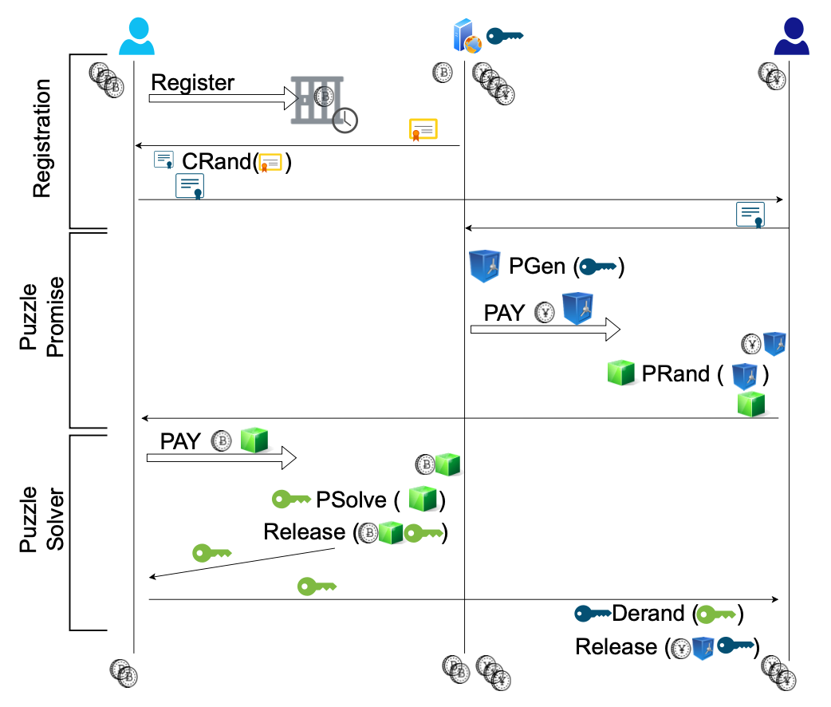
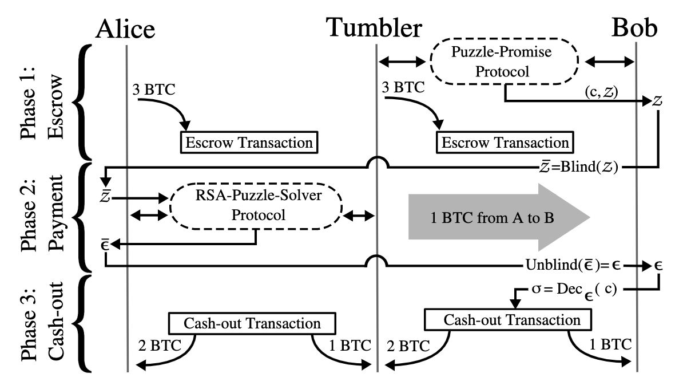
1.3 Griefing Attack
Griefing Attack is the DoS attack against the tumbler. Concretely, the payee starts the puzzle-promising phase with the tumbler but with no puzzle-solving phase following. Consequently, the tumbler’s coins in the tumbler-payee channel are locked in vain.
E. Heilman et al., “Tumblebit: An untrusted bitcoin-compatible anonymous payment hub,” in Network and Distributed System Security Symposium, 2017.
E. Tairi et al., “A2l: Anonymous atomic locks for scalability in payment channel hubs,” in 2021 IEEE Symposium on Security and Privacy (SP). IEEE, 2021, pp. 1834– 1851.

Slide 7
1.4 Security and Privacy Goals
Atomicity: For any payment of m coins from S to R, the PCH should ensure that either R receives m coins from T and T receives m coins from S, or both parties receive none.
Value Privacy: T should not know the payment amount between S and R.
Relationship Anonymity: T should not be able to find out if there is any relation between S and R of a specific payment (with variable amount).
Griefing Resistance: The PCH should only initiate a payment procedure if R can prove that the payment request are previously backed by some coins locked by a S during the payment procedure.

Slide 8
1.5 Abstract
PCH Definition:
Payment Channel Hub (PCH) is a promising solution to the scalability issue of first-generation blockchains or cryptocurrencies such as Bitcoin. It supports off-chain payments between a sender and a receiver through an intermediary (called the tumbler).
Problem:
All existing Bitcoin-compatible PCH constructions that guarantee relationship anonymity allow only a (predefined) fixed payment amount.
This work:
The first Bitcoin-compatible PCH that provides security & privacy with variable amount.
Blind Adaptor Signature, an adaptor signature protocol built on top of a blind signature scheme.
Blind Channel, one of the channel parties is unable to see the channel balances.
Blind Hub, a three-party (sender, tumbler, receiver) protocol for private conditional payments.

Slide 9
2 Preliminaries

Slide 10
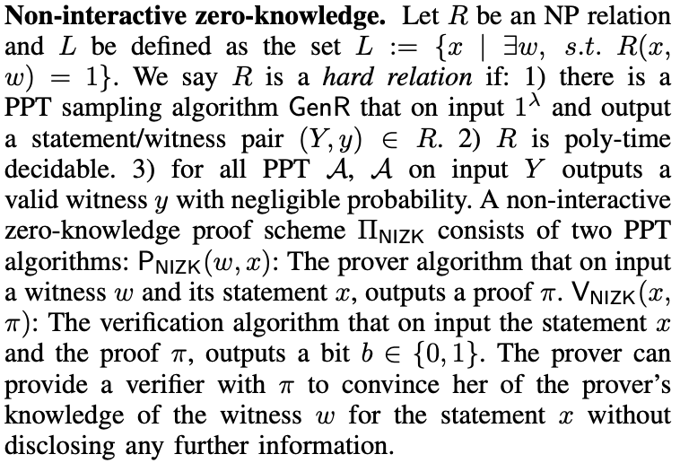
2.1 NIZK

Slide 11
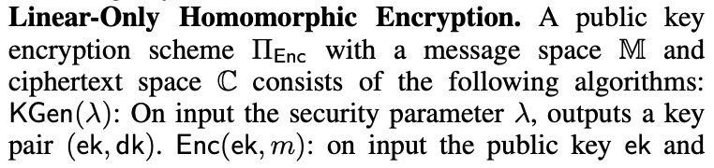
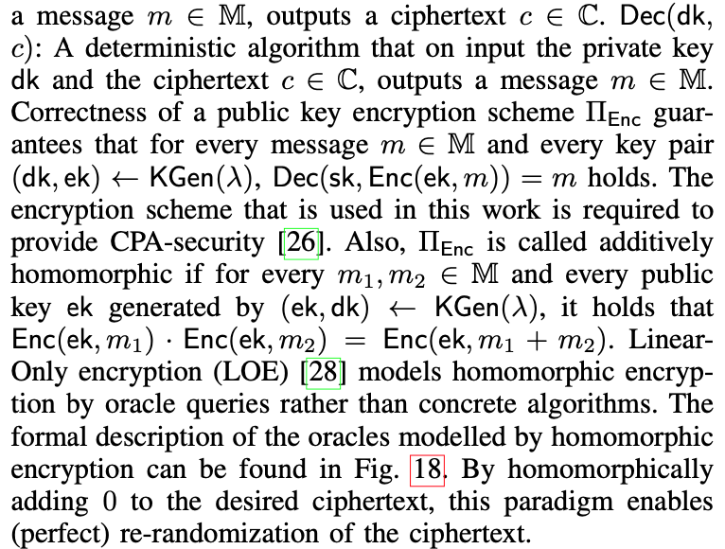
2.2 Linear-Only Homomorphic Encryption

Slide 12
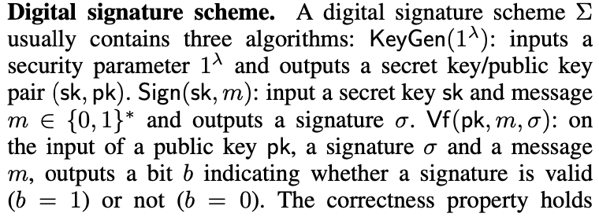
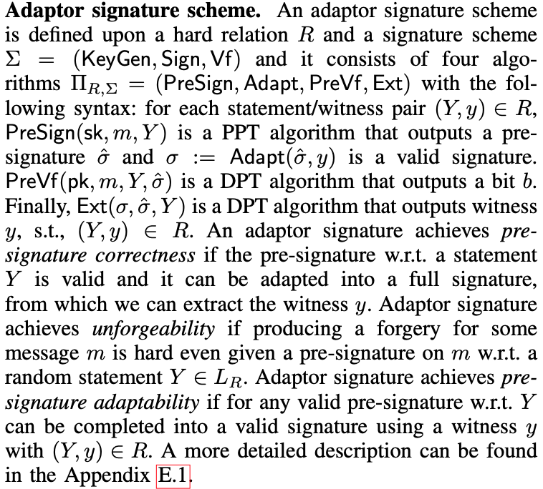
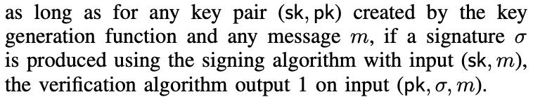
2.3 Adaptor Signature

Slide 13
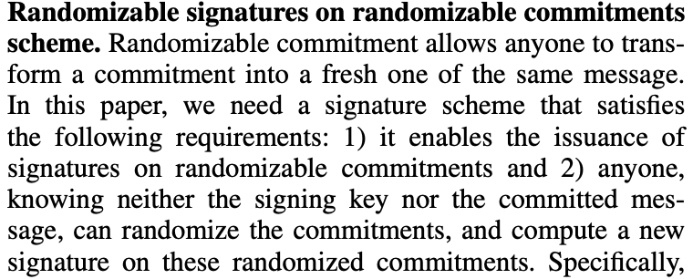
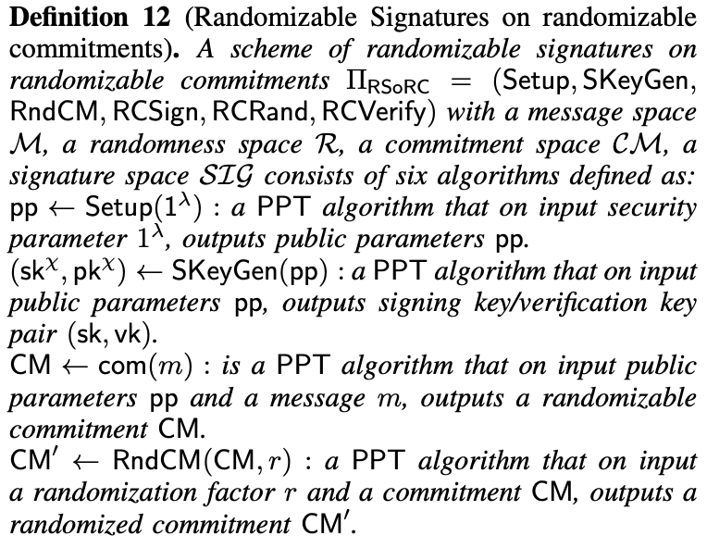
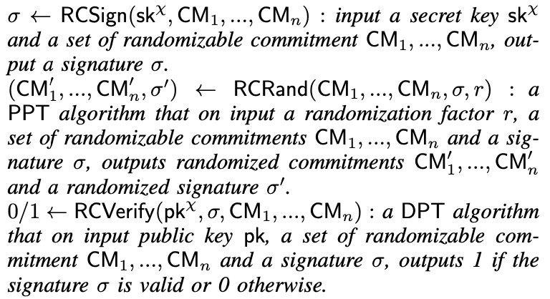
2.4 Randomizable Signatures on Randomizable Commitments

Slide 14
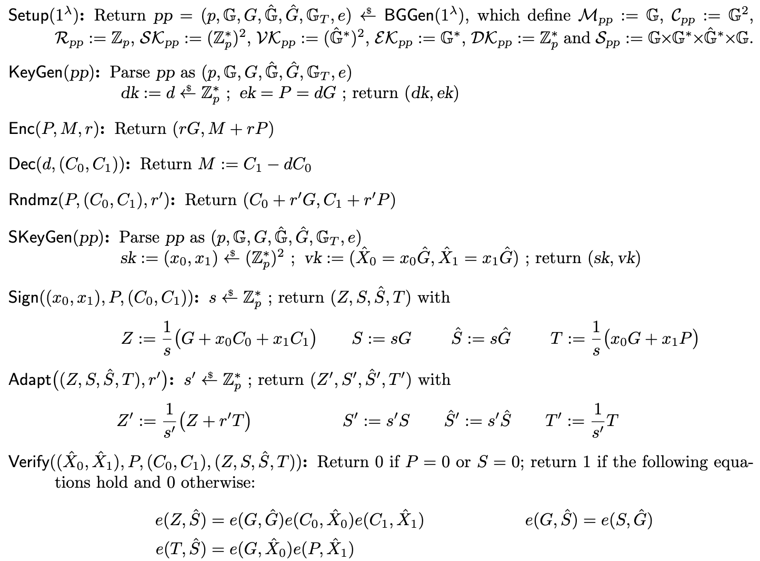
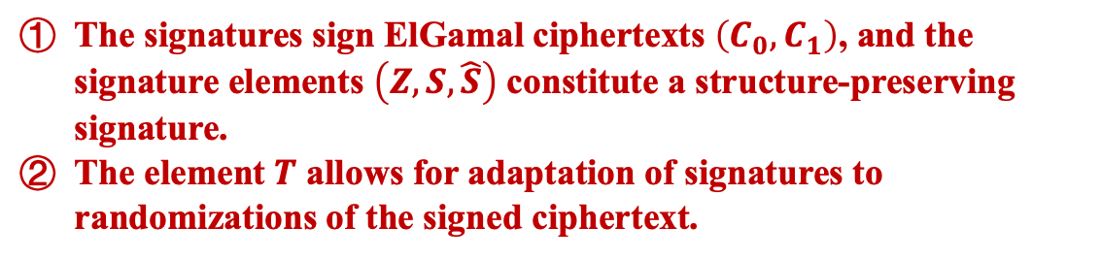
2.4 Randomizable Signatures on Randomizable Commitments
The signatures sign ElGamal ciphertexts $\left(C_{0}, C_{1}\right)$, and the signature elements $\left(Z, S, \hat{S}\right)$ constitute a structure-preserving signature.
The element $T$ allows for adaptation of signatures to randomizations of the signed ciphertext.
B. Bauer and G. Fuchsbauer, “Efficient signatures on randomizable ciphertexts,” in International Conference on Security and Cryptography for Networks. Springer, 2020, pp. 359–381.

Slide 15
3 Overview

Slide 16
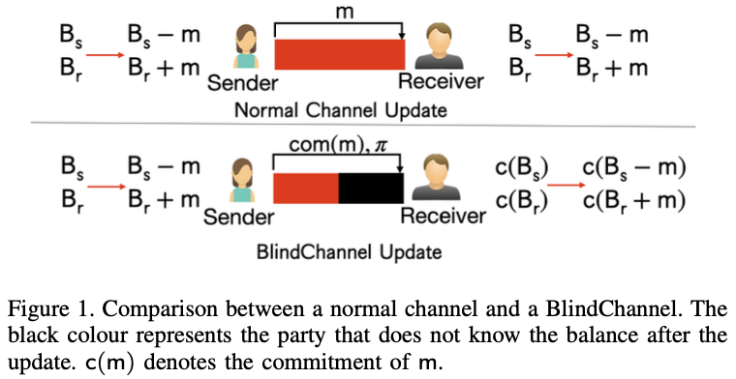
3.1 Blind Channel
Amount Consistency Proof
Unblind Party
Blind Party

Slide 17
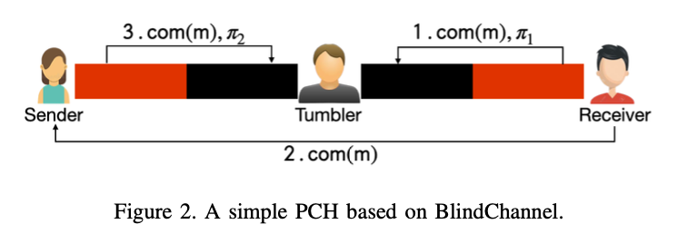
3.2 Value Privacy: A Simple PCH from BlindChannel
Question: a malicious S refuse to pay T after R is paid by T, hence a loss of T’s money.
Amount Consistency Proof

Slide 18
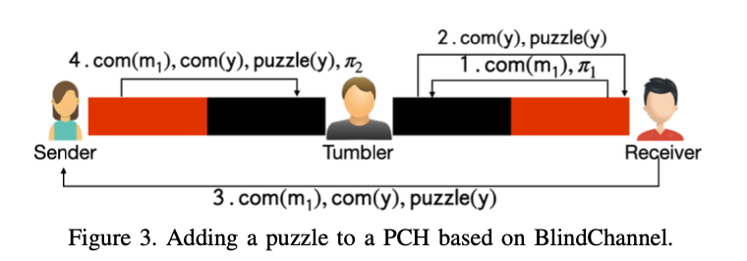
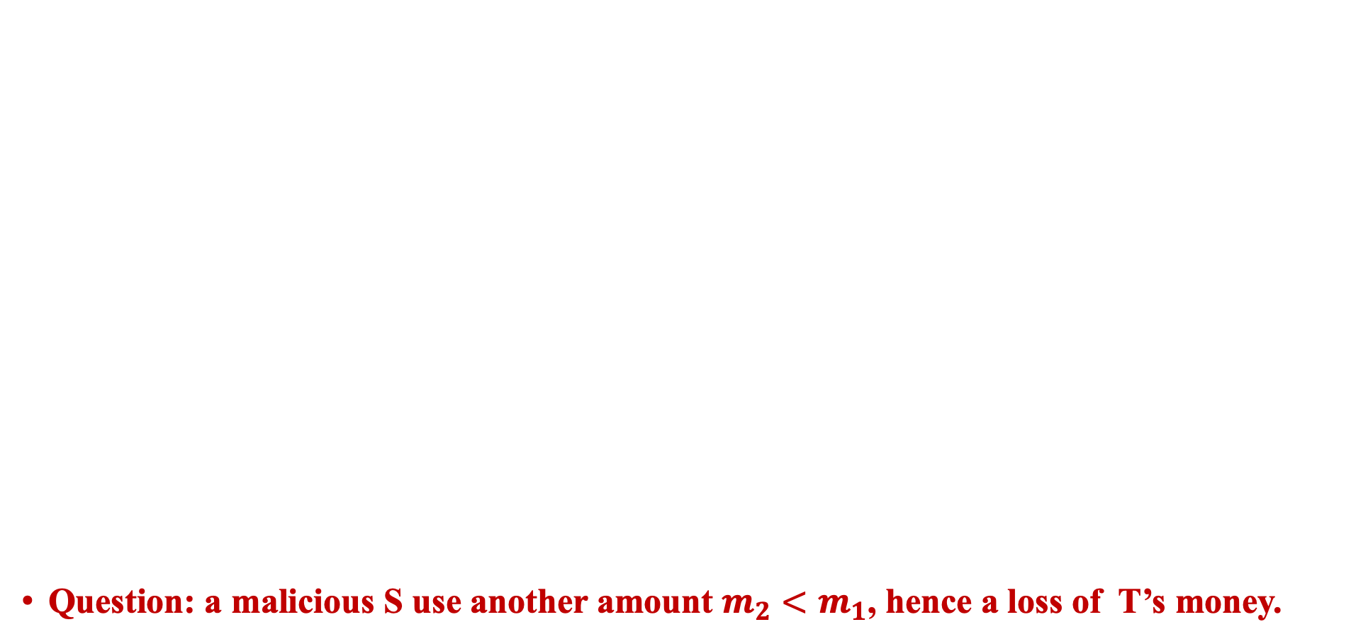
3.3 Atomicity: Linking Puzzle with Transaction Amount
Question: a malicious S use another amount $m_{2}<m_{1}$, hence a loss of T’s money.
Conditional State

Slide 19
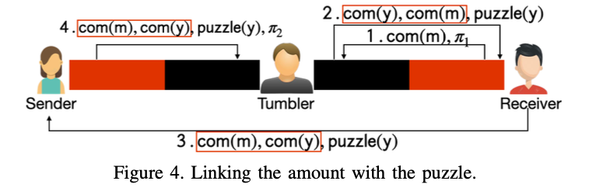
3.3 Atomicity: Linking Puzzle with Transaction Amount
Question: T can easily know the relationship between S and R by observing which pair of sender and receiver share the same commitment of the amount, the puzzle and the link.
link

Slide 20
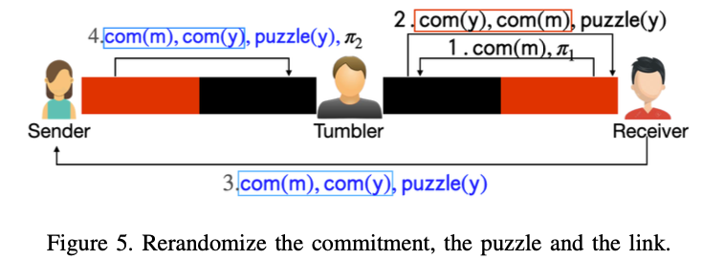
3.4 Relationship Anonymity: Randomizable Commitment, Puzzle and Linkage
Question: Griefing Attack.

Slide 21
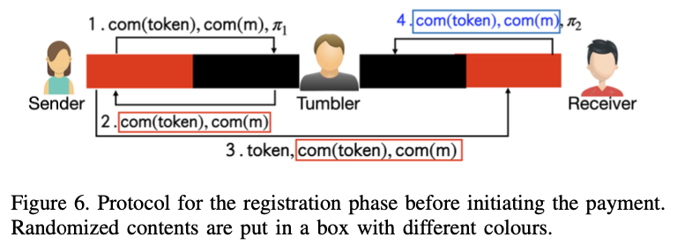
3.5 Griefing Resistance: Linking Token with Transaction Amount

Slide 22
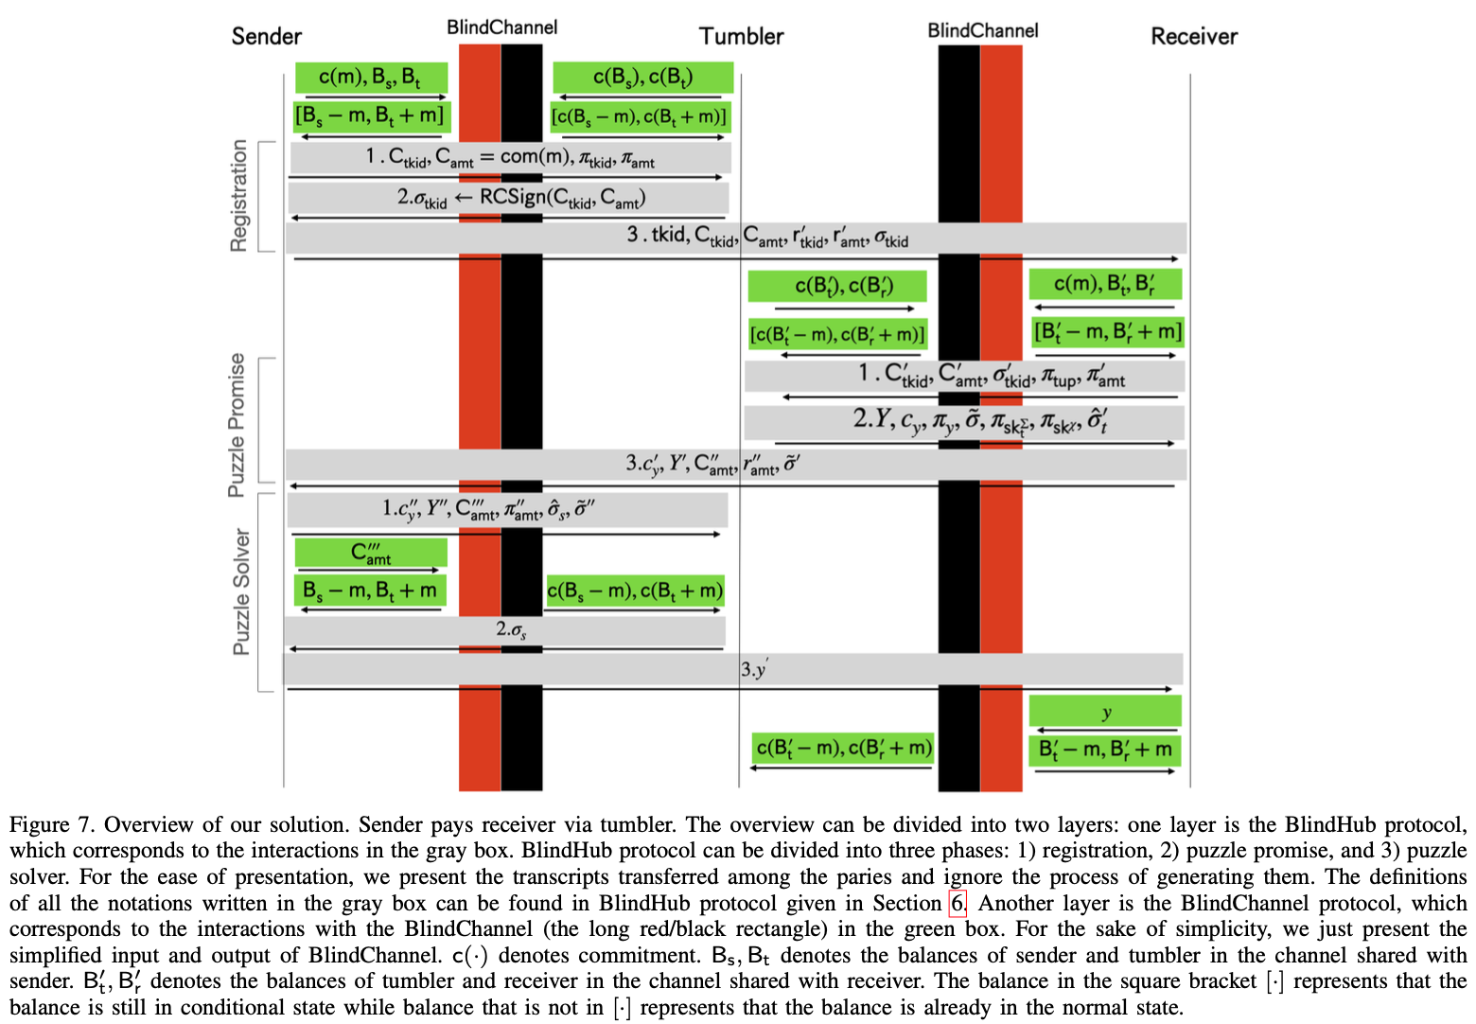
3.6 Scheme Overview
Randomizable Link ←→ RSoRC
Randomizable Puzzle ←→ LOE
Conditional Channel Update ←→ BAS

Slide 23
4 Blind Adaptor Signature

Slide 24
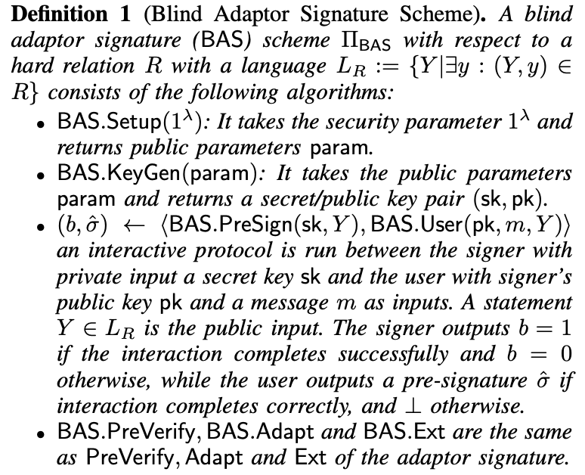
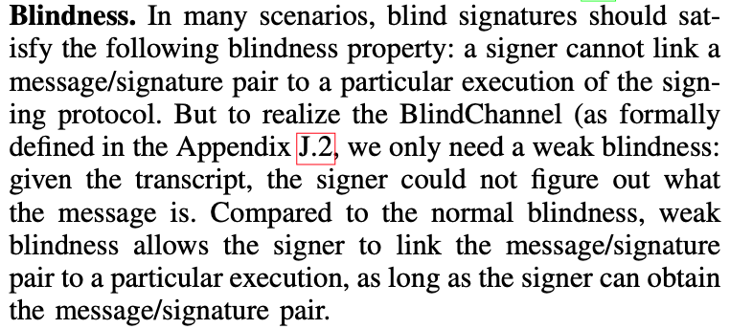
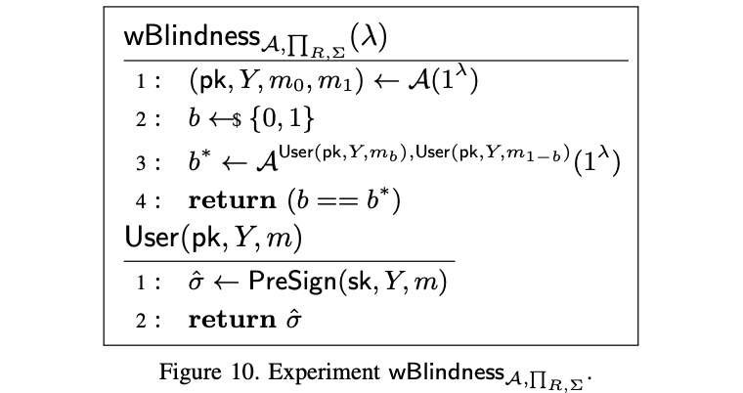
4.1 Blind Adaptor Signature

Slide 25
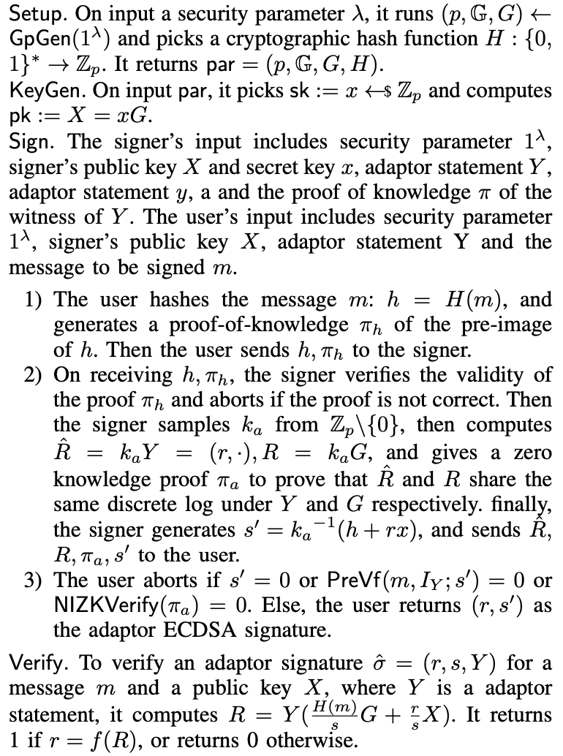
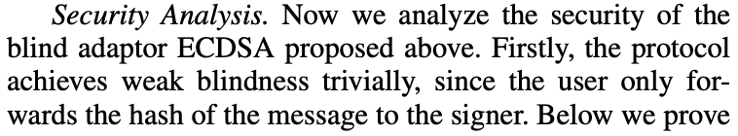
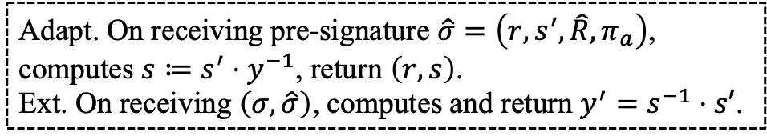
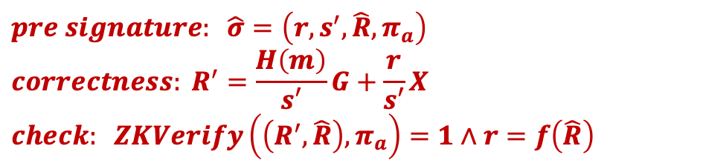
4.2 Blind Adaptor ECDSA Construction
$$pre signature: \hat{σ}=\left(r,s^{′},\hat{R},π_{a}\right)$$
$$correctness: R^{′}=\frac{H\left(m\right)}{s′}G+\frac{r}{s′}X$$
$$check: ZKVerify\left(\left(R^{′},\hat{R}\right),π_{a}\right)=1∧r=f\left(\hat{R}\right)$$
Adapt. On receiving pre-signature $\hat{σ}=\left(r,s^{′},\hat{R},π_{a}\right)$, computes $s≔s^{′}⋅y^{−1}$, return $\left(r,s\right)$.
Ext. On receiving $\left(σ,\hat{σ}\right)$, computes and return $y^{′}=s^{−1}⋅s′$.

Slide 26
5 Blind Channel

Slide 27
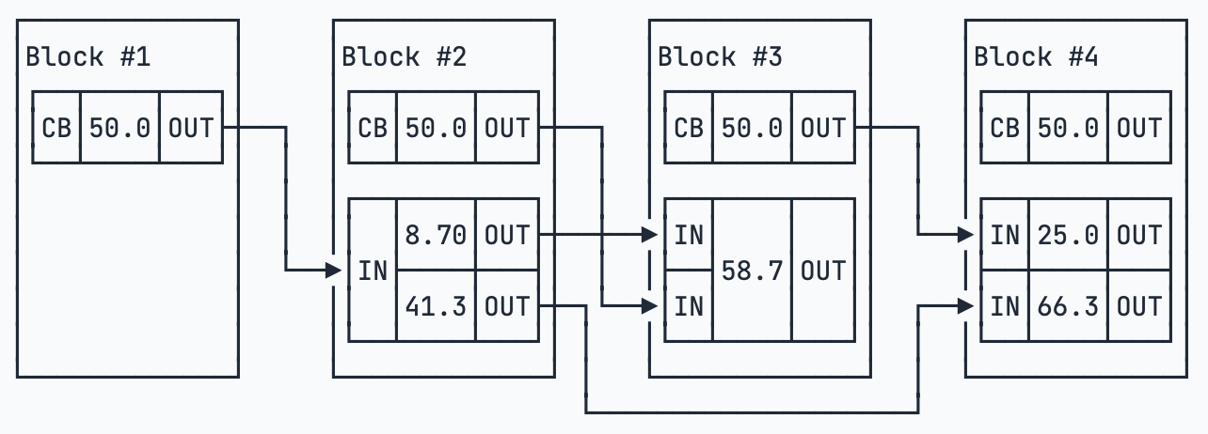
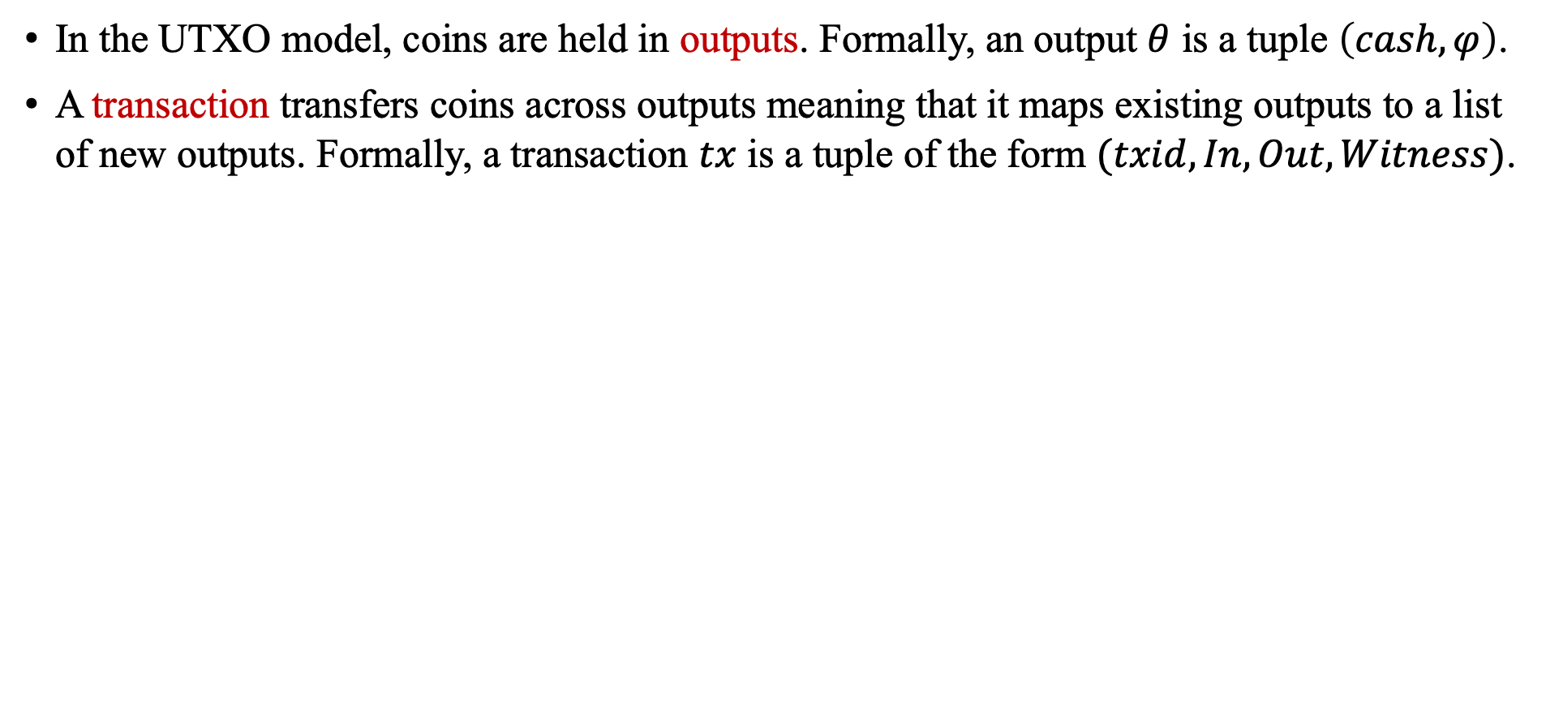
5.1 Unspent Transaction Output (UTXO) Model
In the UTXO model, coins are held in outputs. Formally, an output $θ$ is a tuple $\left(cash,φ\right)$.
A transaction transfers coins across outputs meaning that it maps existing outputs to a list of new outputs. Formally, a transaction $tx$ is a tuple of the form $(txid, In, Out, Witness)$.

Slide 28
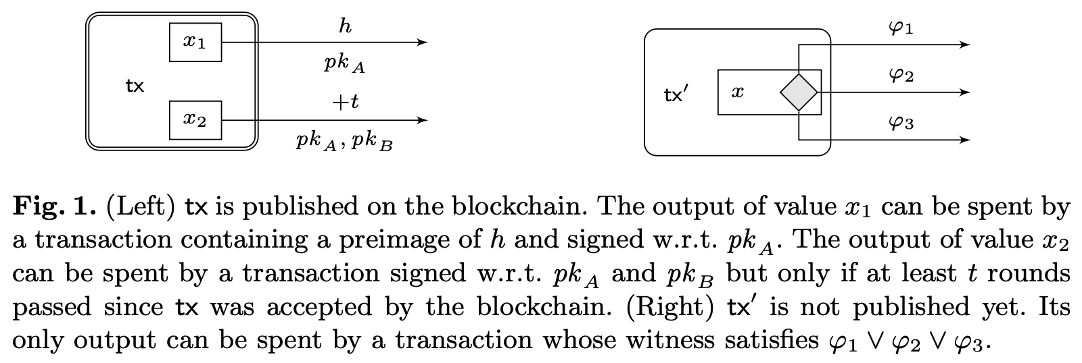
5.1 Unspent Transaction Output (UTXO) Model

Slide 29
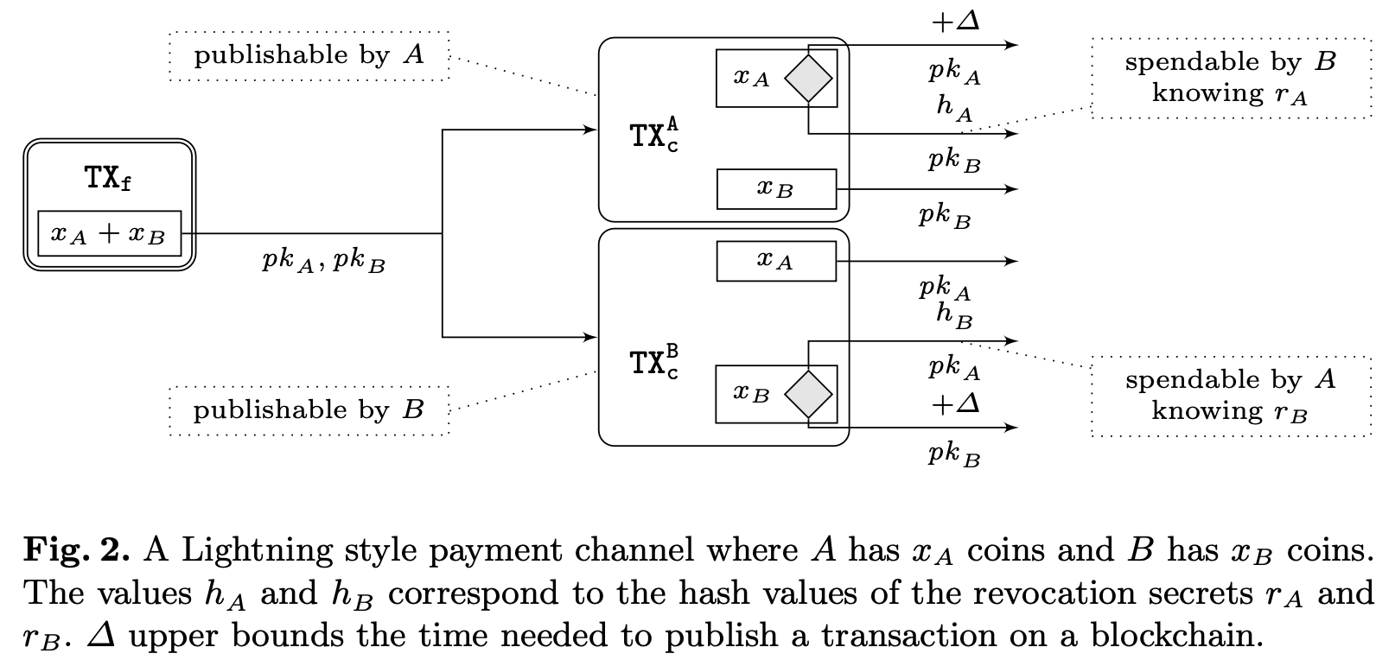
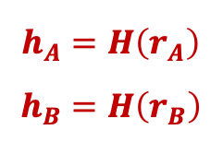
5.2 Lightning Style Payment Channel
Generated by Bob
$$h_{A}=H\left(r_{A}\right)$$
$$h_{B}=H\left(r_{B}\right)$$
Generated by Alice

Slide 30
5.2 Lightning Style Payment Channel
Channel Closed Correctly

Slide 31
5.2 Lightning Style Payment Channel
Malicious User Publish Old State
Punishment
Punishment

Slide 32
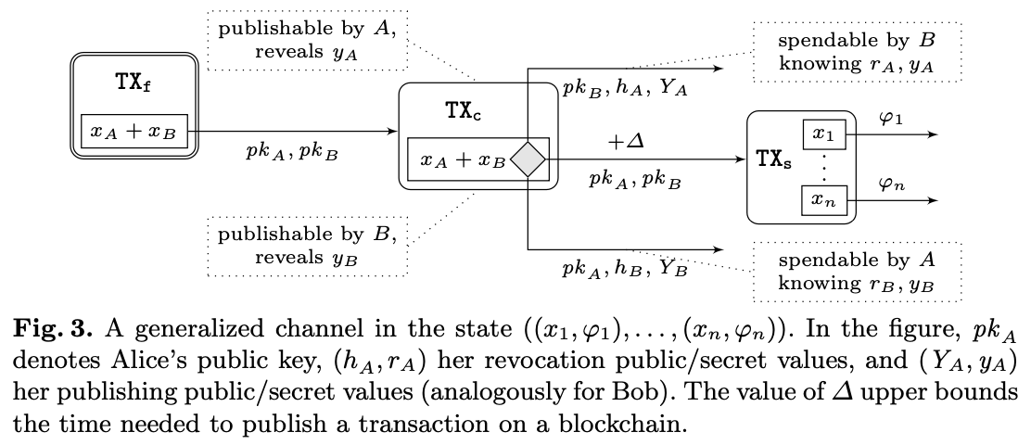
5.3 Generalized Channel
Generalized channels enable parties agree on any conditional payment that they could do on-chain (Not only for Turing-complete scripting languages).
One commit transaction per channel update.
L. Aumayr et al., “Generalized channels from limited blockchain scripts and adaptor signatures,” in ASIACRYPT, Lecture Notes in Computer Science, vol. 13091. Springer, 2021.

Slide 33
5.4 Blind Channel: Requirements
Consensus: A Blind Channel is successfully created/updated only if both parties in the channel agree with the creation/update.
Finality: An honest party P in the channel has the guarantee that either the current state of the channel can be enforced on the ledger, or P can enforce a state where she gets all coins in the channel.
Privacy: The blind party could not figure out the way channel funds are redistributed.
Conditional: As required by Blind Hub protocol, all payments are conditioned on solving a puzzle.

Slide 34
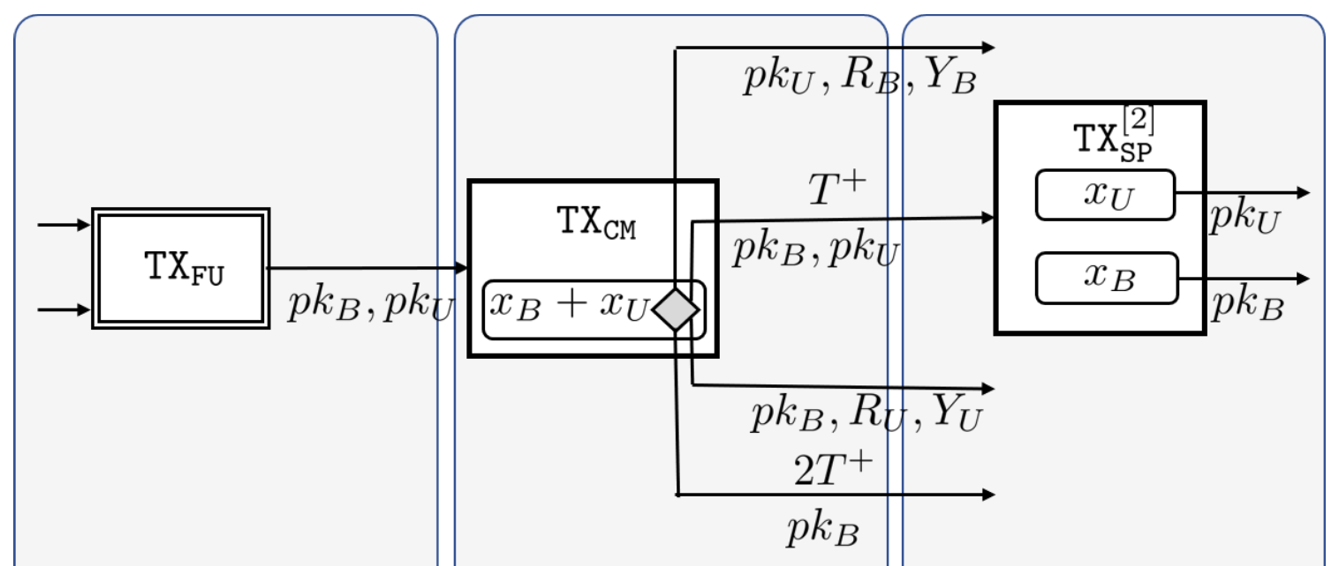
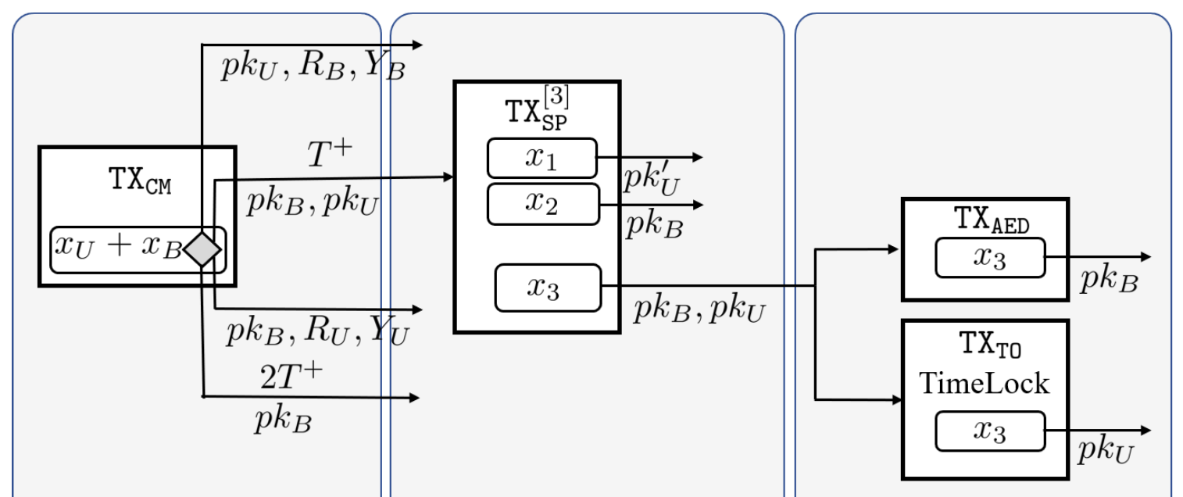
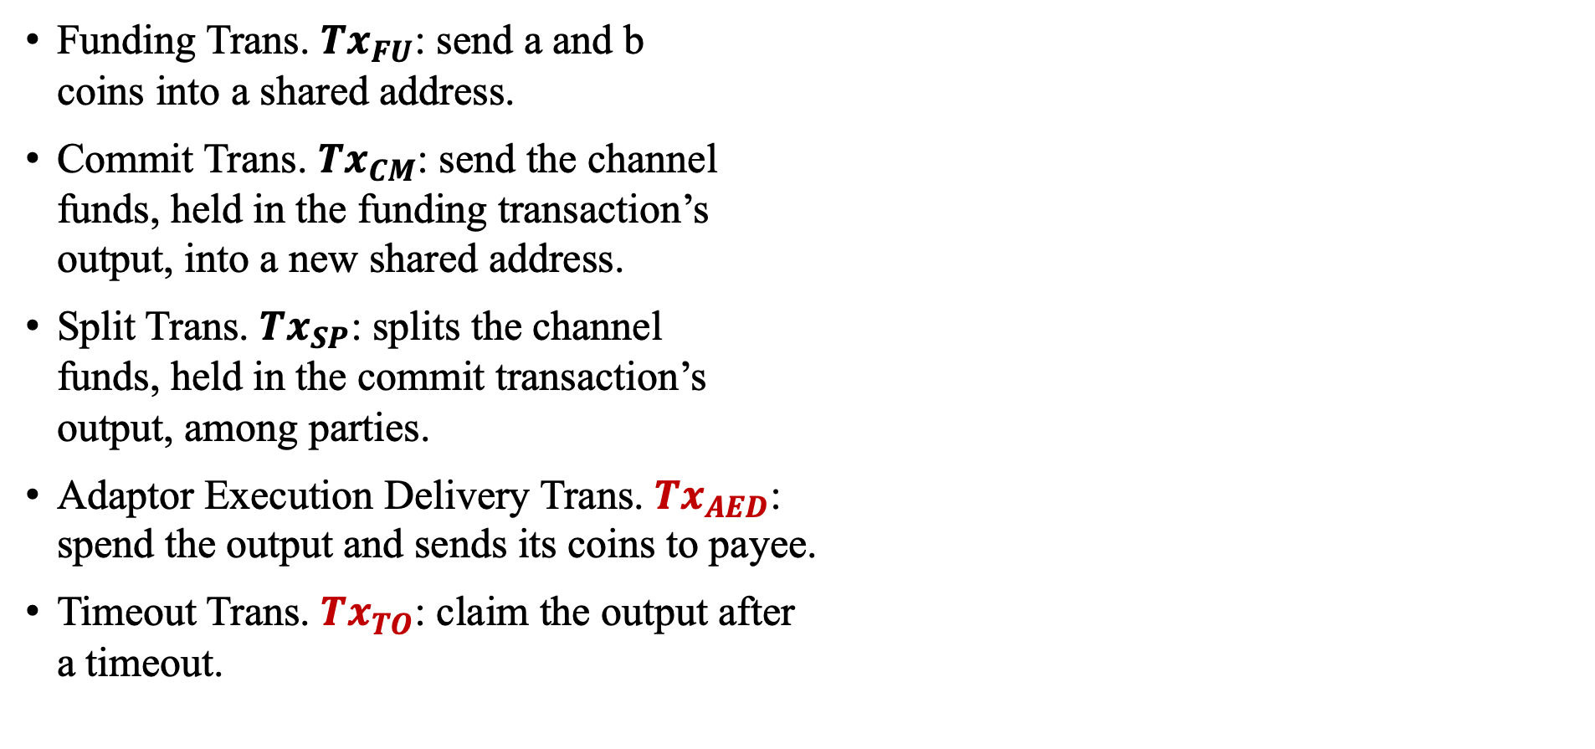
5.4 Blind Channel: Transaction Types
Funding Trans. $Tx_{FU}$: send a and b coins into a shared address.
Commit Trans. $Tx_{CM}$: send the channel funds, held in the funding transaction’s output, into a new shared address.
Split Trans. $Tx_{SP}$: splits the channel funds, held in the commit transaction’s output, among parties.
Adaptor Execution Delivery Trans. $Tx_{AED}$: spend the output and sends its coins to payee.
Timeout Trans. $Tx_{TO}$: claim the output after a timeout.

Slide 35
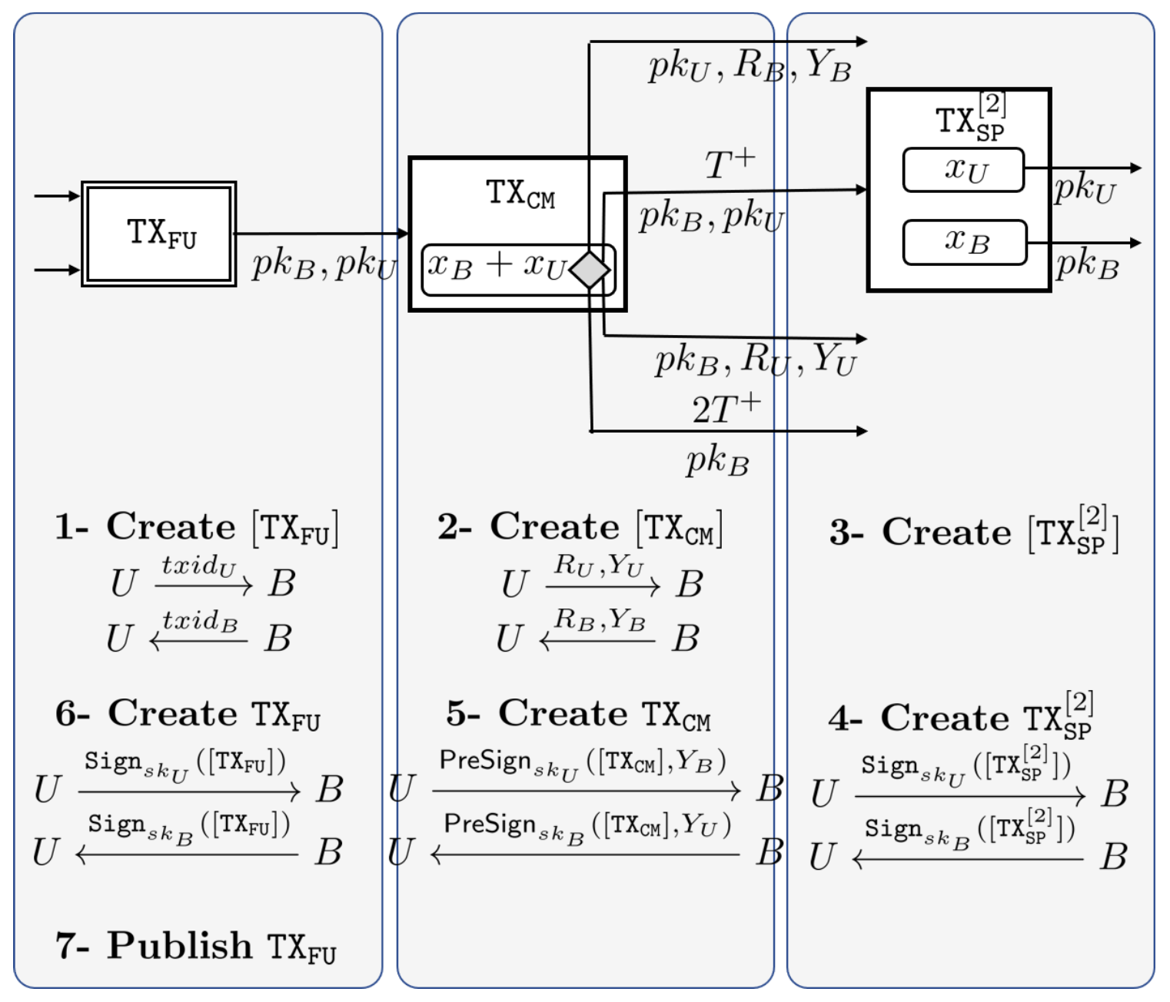
5.4 Blind Channel: Create
Same as Generalized Channel

Slide 36
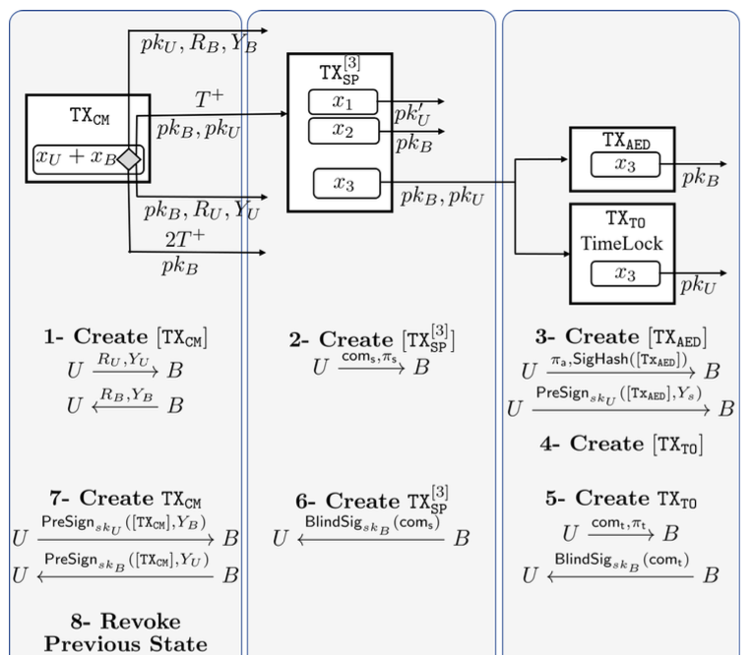
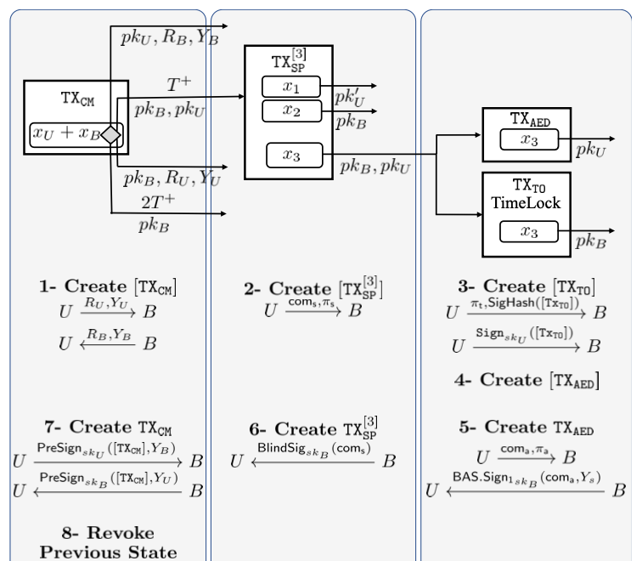
5.4 Blind Channel: Update

Slide 37
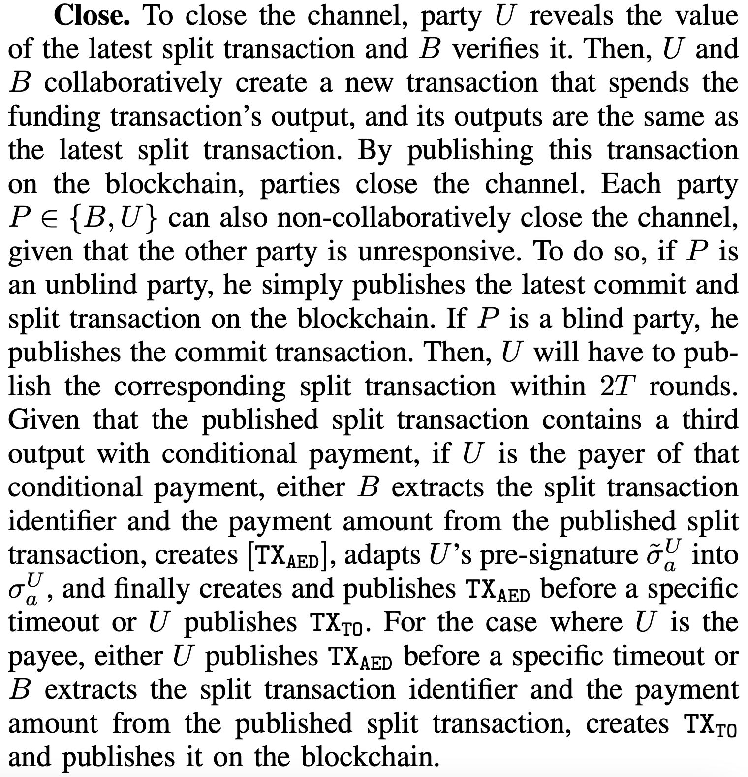
5.4 Blind Channel: Close

Slide 38
6 Blind Hub

Slide 39
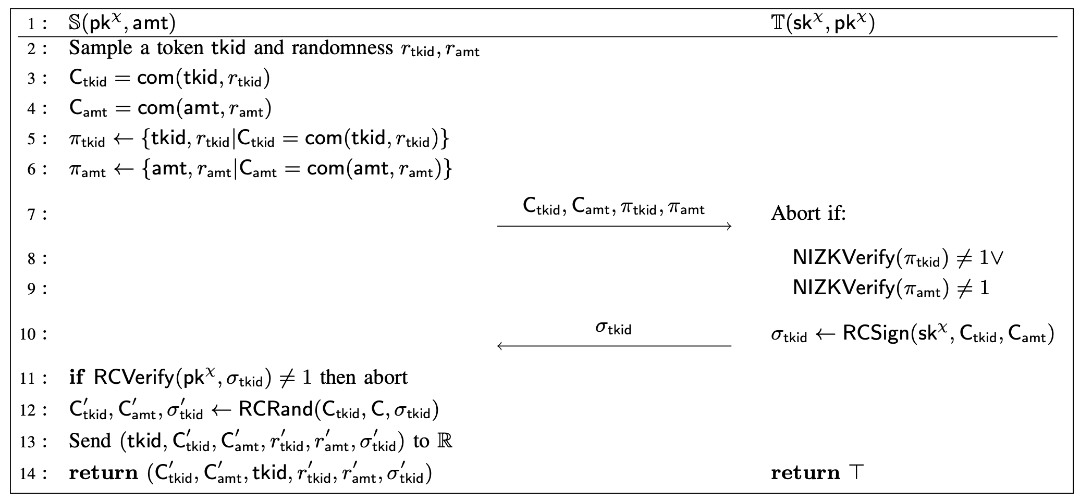
6.1 Registration
Hidden token
Hidden amount
Sign token
Randomize

Slide 40
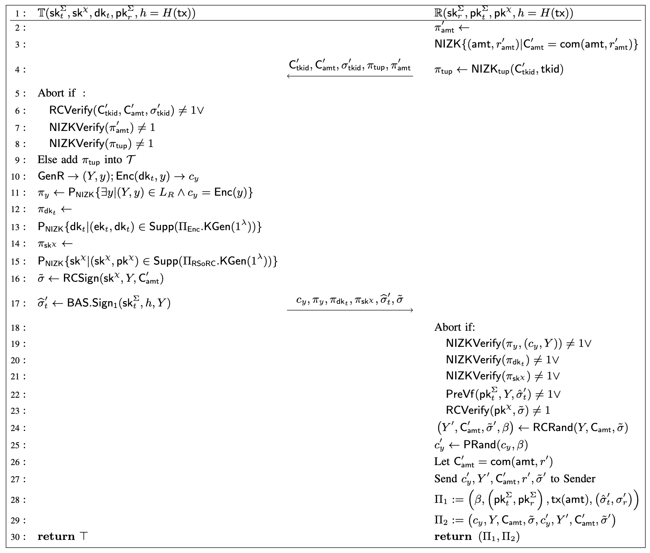

6.2 Puzzle Promise
Token-uniqueness proof
Amount consistency proof
Generate a hard relation and encrypt the solution y
Link amount and puzzle
Generate blind pre-signature of $Tx$
Rerandomize

Slide 41
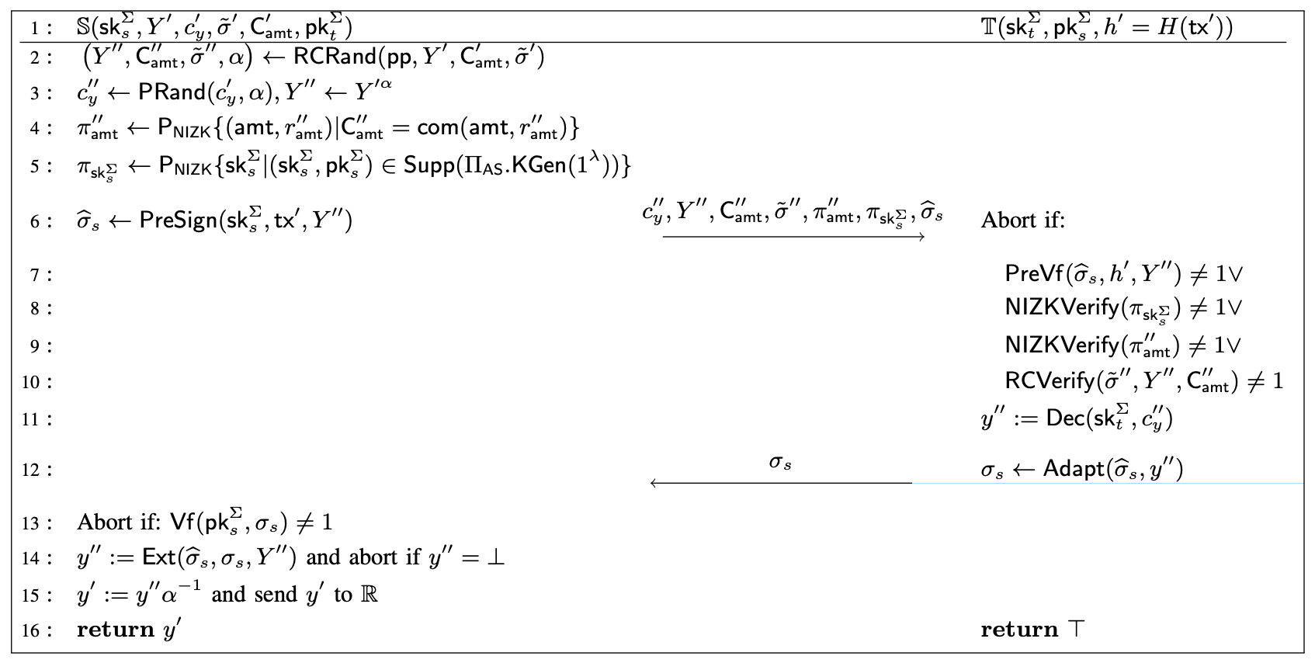

6.3 Puzzle Solver
Rerandomize
Generate blind pre-signature of $Tx$
Decrypt the solution
Adapt the signature
Remove randomness

Slide 42
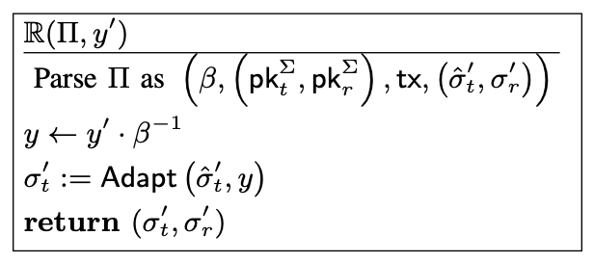
6.4 Blind Hub: Open
Remove randomness
Adapt signature
Publish

Slide 43
7 Performance Analysis

Slide 44
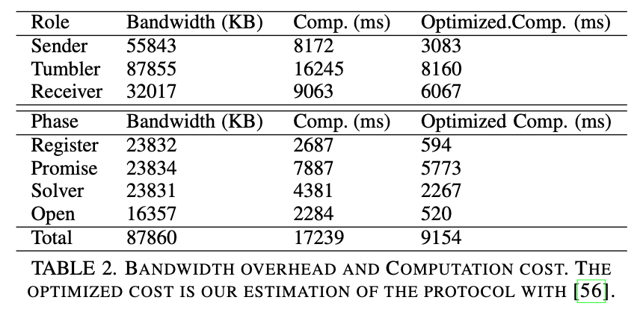
7.1 Performance Analysis
ECDSA-based adaptor signature / ECDSA-based blind adaptor signature with secp256k1.
RSoRC scheme with BLS12-381.
HSM-CL encryption scheme.
Pedersen commitment scheme.
Garbled circuit-based ZKP.
An overall running time of ∼31 s for one payment.

Slide 45
Thanks! Questions?

